Slide 1
The right time to buy? Interest Rates and The Housing Market
Dan Cimiluca Fall 2020
Notes:
Hi everyone, my name is Dan and I'm doing my capstone in Data Science at UMBC on determining whether or not falling interest rates indicate a favorable buyers housing market.
This topic is interesting to me because in my current occupation I forecast losses on a mortgage portfolio, and have seen first hand how preconceived notions regarding the housing market are not always true

Slide 2
We are in unprecedented times
In early 2020 the Federal Funds rate was cut to nearly zero in an attempt to mitigate pending economic damage caused by COVID-19
As unemployment skyrocketed many feared a housing crisis could be looming, and massive defaults were inevitable
Notes:
This problem is especially interesting right now because we are in unprecedented times
The fed fund rate, which is the rate banks are able to lend to each other overnight and influences most other rates, was cut to nearly zero early this year
This was done in an attempt to mitigate pending economic damage caused by COVID-19
As unemployment skyrocketed many feared another housing crisis was looming, with massive defaults on mortgages in inevitable
Lower rates combat this and make home buying more attractive, which I'll illustrate shortly

Slide 3
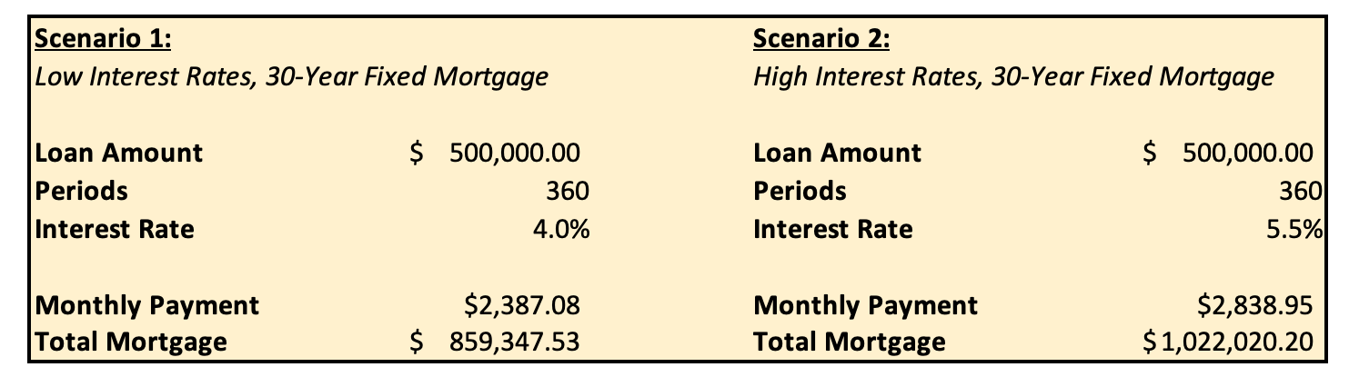
Conventional wisdom says to buy when rates are low
Total Savings: $162,672.67
Notes:
I want to show an example of why conventional wisdom is to buy while interest rates are low
Here we have two scenarios: both for $500k 30 year fixed mortgages
In scenario 1 the interest rate is 4.0%, scenario 2 the interest rate is 150 basis points higher at 5.5%
As you can see the lower rate in this case saves the borrower almost $163k over the life of the loan
This simple math illustrates the profound impact interest rates can have on a borrowers total expense when taking out a mortgage
So it's pretty clear why the fed would want to slash rates

Slide 4
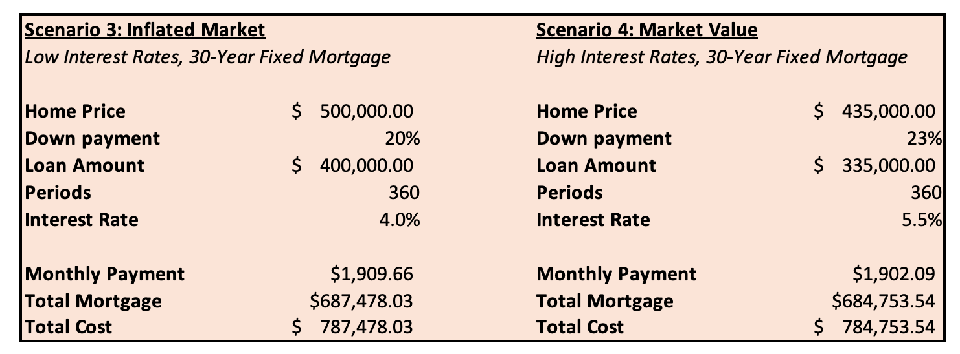
But is this always the best move?
Total Savings: $(2724.49)
Notes:
But is purchasing while rates are low always the best for the buyer?
Not necessarily, here we have two similar scenarios for 30 year fixed rate mortgages but in scenario 3 the borrower is paying around a 15% premium on their home with a 4.0% interest rate, while they're paying market value in scenario 4 with the higher 5.5% rate
In both scenarios the borrower is able to make a $100k down payment, which ends up being a larger portion of the home sold at market value
Despite the significantly higher interest rate, the monthly payments and total cost end up being slightly lower in scenario 4 because of the difference in principal on the loan
This is where the question becomes a data science question, it's impossible to know exactly what the market value of the home is but we can derive estimates and find insight about the future using data from the past

Slide 5
How data science can help
Uncover relationships between interest rates and the housing market
Build models to forecast market reactions to rate changes
1
Use models to determine optimal conditions for buyers
2
3
Notes:
Data science can help us determine the relationship between different interest rates and the housing market
Now more than ever an abundance of data is available to the public regarding home prices, available listings, time to sale, price cuts, and other metrics to gage whether the market is more favorable for buying or selling
We can develop models using this data to predict how the housing market will change given a rate environment
These models can help us determine true optimal buying conditions. This could look like periods of stable home value growth, median listing price close to median sale price, things of that nature

Slide 6



Implementation
Data Cleansing
Model Development
Visualization
Extract data from sources in CSV format
Homogenize data for model consumption using Numpy, Pandas and other Python libraries
Develop models for different buying demographics using Python e.g. rural/urban, first time buyer, fixed/ARM etc..
Begin with developing Autoregression models from scikit learn
Use models to determine short and long term home appreciation given a rate and set of market conditions
Visualize results and any significant insights through tableau
Notes:
To achieve this I plan to use a number of different tools
To kick off the process I've extracted data from a number
I'm working to homogenize the data to be ready for model consumption
The next big step is model development
I plan to develop multiple autoregression models, which are a form of regression modeling useful for timeseries datasets that uses previous observations as inputs in determining model output
My goal is for these models to determine expected home appreciation given an interest rate and set of market conditions,
These can be used to forecast optimal market conditions for home buyers
Lastly I plan to put most visualizations together using tableau

Slide 7
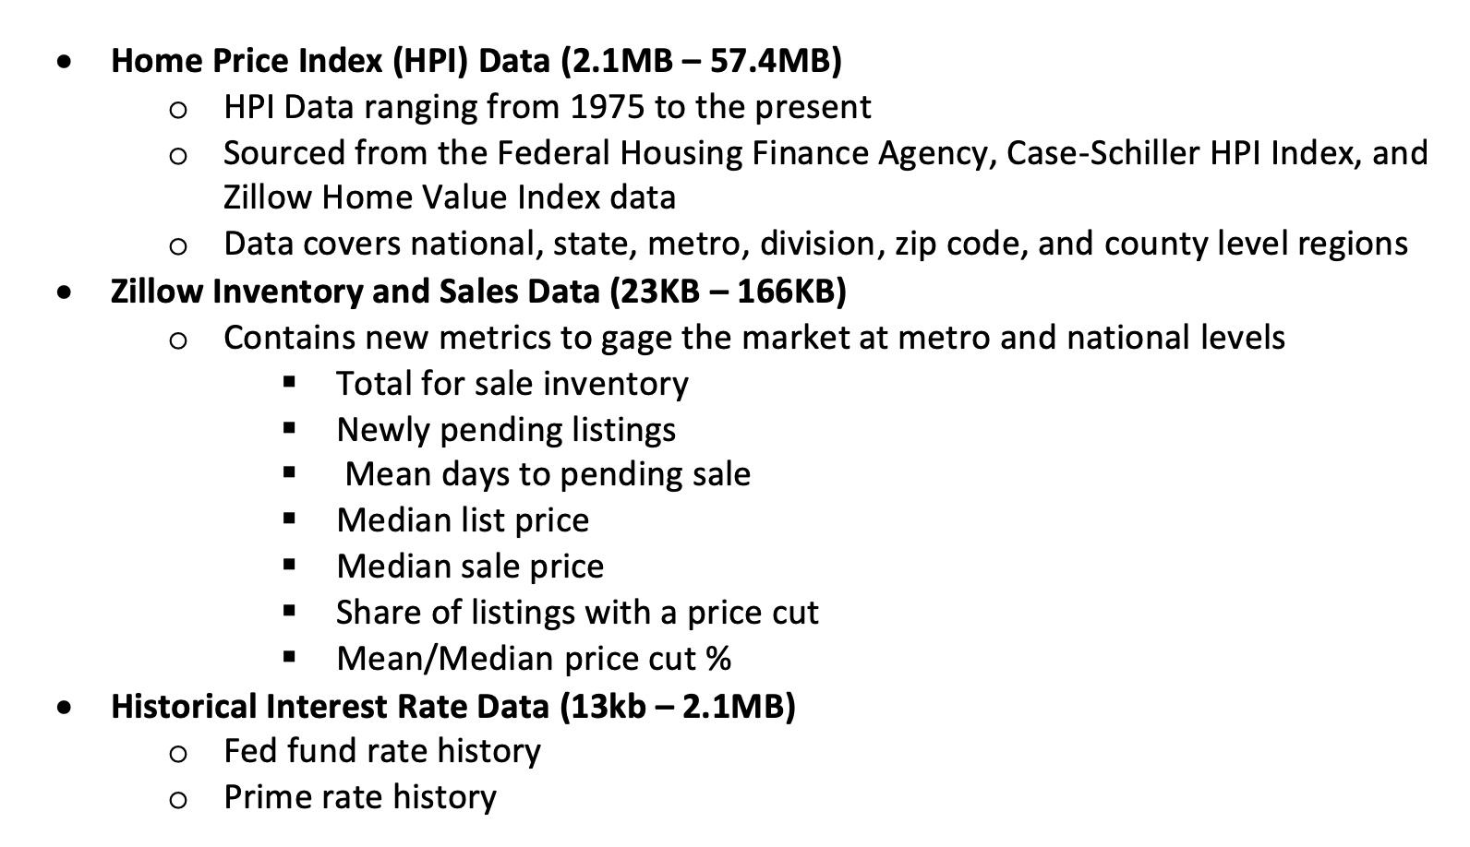
Datasets
Notes:
I'm using three primary types of data
The first is Home Price Index or HPI data,
This is a measure of the percent of price change in residental homes given an index value. I've sourced these from the federal housing and finance agency, zillow, and case-schiller
The second data is other relevant housing market metrics sourced from zillow which include mortgage inventory, median list and sale prices, and number of price cuts amount other things
Lastly, I'll be using a dataset containing historical interest rates from the fed fund rate and prime rate, the prime rate is typically the lowest rate a bank will lend money to customers

Slide 8
Literature Review
“Interest Rates and house prices in the United States and around the world”¹
Study conducted by the Bank of International Settlements
Compared house price series data from the U.S. and 47 other countries against rate changes through 2015
Concluded short-term rates were negatively correlated with home prices
“The Sensitivity of Housing Demand to Finance Conditions: Evidence from a Survey”²
Study conducted by the New York Fed
Used survey questions to determine buyers willingness to pay (WIP) for a home based on a series of conditions
Concluded that mortgage rates did not contribute significantly to WIP and models could be overstating rates impact on the home prices
Notes:
I found two interesting studies while performing my literature review
The first was a study conducted by the bank of international settlements that compared historical home price series from the U.S. and 47 other countries against rate changes
They found that there was a statistically significant negative correlation between rates and home prices, suggesting a Bayesian estimate relying on random walk prior modeling (a specific type of autoregression model that assumes each step in a time series takes a random step away from the previous data point) would underestimate interest rate impact.
They opted to use a regression equation to model the relationship.
The other study was conducted by the New York State Fed
It asked four survey questions changing variables around rate, principal payment, and other factors that could influence what a borrower was willing to pay
Concluded mortgage rates did not contribute significantly to a buyers willingness to pay
suggesting current models could be overstating rates impacts on home prices

Slide 9
How will this project be different?
Taking a fundamentally different approach than the New York Fed’s study which relies on collecting and analyzing survey data, as I’ll be working with historical data
Focusing on one specific country for my analysis allowing more granular data than the BIS study
Incorporating additional housing market metrics into models beyond national level home price data
Data includes more recent market performance, previous studies used data through 2015
Notes:
The approach I'm taking with my project is fundamentally different than the survey based study the New York Fed conducted as I'm relying on analyzing historical data
My project will be focusing on a single country, allowing for more granular data to be analyzed such as purchase data at MSA and zip code level allowing for less broad models
I also plan to incorporate other market metrics into the my project including available home listings and median sale vs list price to gain other market insights
Lastly my project will be using additional data for analysis, going through August 2020

Slide 10
Thank you for your time!
For questions or comments I can be reached at: dcimilu1@umbc.edu
Notes:
Thank you for watching my presentation
If you have any questions or comments I can be reached at the email address provided on this slide

Slide 11
References
Sutton, Mihaljek, Subelyte. “Interest rates and house prices in the United States and around the world”, Bank For International Settlements, Oct. 2017, https://www.bis.org/publ/work665.pdf. Accessed September 2020.
Fuster, Basit. “Demand to Financing Conditions: Evidence from a Survey”, Federal Reserve Bank of New York, Aug. 2015, https://www.newyorkfed.org/medialibrary/media/research/staff_reports/sr702.pdf. Accessed September 2020.
Notes:
The approach I'm taking with my project is fundamentally different than the survey based study the New York Fed conducted as I'm relying on analyzing historical data
My project will be focusing on a single country, allowing for more granular data to be analyzed such as purchase data at MSA and zip code level allowing for less broad models
I also plan to incorporate other market metrics into the my project including available home listings and median sale vs list price to gain other market insights
Lastly my project will be using additional data for analysis, going through August 2020

